Slide 1
WP progress*
(* ) Just the main highlights. I’m not entering in details about what data matters, parameterizing stochastic models, nor validation techniques => Black Box

Slide 2
Agenda
Network traffic generators
Realistic traffic generation Issues
Consolidation: Architecture
Status
Conclusion

Slide 3
Network traffic generators
There are many open-source traffic generators and network benchmark tools available (still incomplete list)
Each one has its own set of features
Class | Available tools
Application-level traffic generators | EAR, ParaSynTG, Youtube Workload Generator, Graphy-Based Traffic Generator, SURGE, MACE, UniLoG, GenSyn
Flow-level traffic generators | Harpoon
Packet-level traffic generators | D-ITG, Ostinato, Seagull, BRUTE, PackETH, Iperf, Netperf, SourcesOnOff, TG, Mgen, KUTE, RUDE & CRUDE, NetSpec, Nping, TCPreplay, TCPivo, Divide and Conquer, NetFPGA PacketGenerator, NetFPGA Caliper, NetFPGA OSNT, Dpdk MoonGen, Dpdk Pktgen, Dpdk NFPA
Closed loop and multilevel traffic generators | Swing, LiTGen

Slide 4
Realistic traffic generation Issues
Packet-Level
Reply engines: TCPreplay, TCPivo, ...
NEED PCAP STORAGE
Model-based: D-ITG, TG, …
NOT AUTOMATIC CONFIGURABLE (PACKET AND FLOW LEVEL)
Maximum Throughput: Ostinato, Seagull, …
NOT AUTOMATIC CONFIGURABLE (PACKET AND FLOW LEVEL)
Application level
ParaSynTG(Web), Youtube Workload Generator(video), ...
TOO SPECIFIC FOR GENERAL PURPOSES

Slide 5
Realistic traffic generation Issues
Flow-level
Flow-patterns replication (based on a trace): Harpoon
NOT-ACCURATE MODELS IN PACKET-LEVEL, NOT SUPPORTED ON NEWER KERNELS
Multilevel
Multilevel modeling: Swing
NOT EXTENSIBLE, FEW PROTOCOLS, COMPLEX MODELS(OVERHEAD)

Slide 6
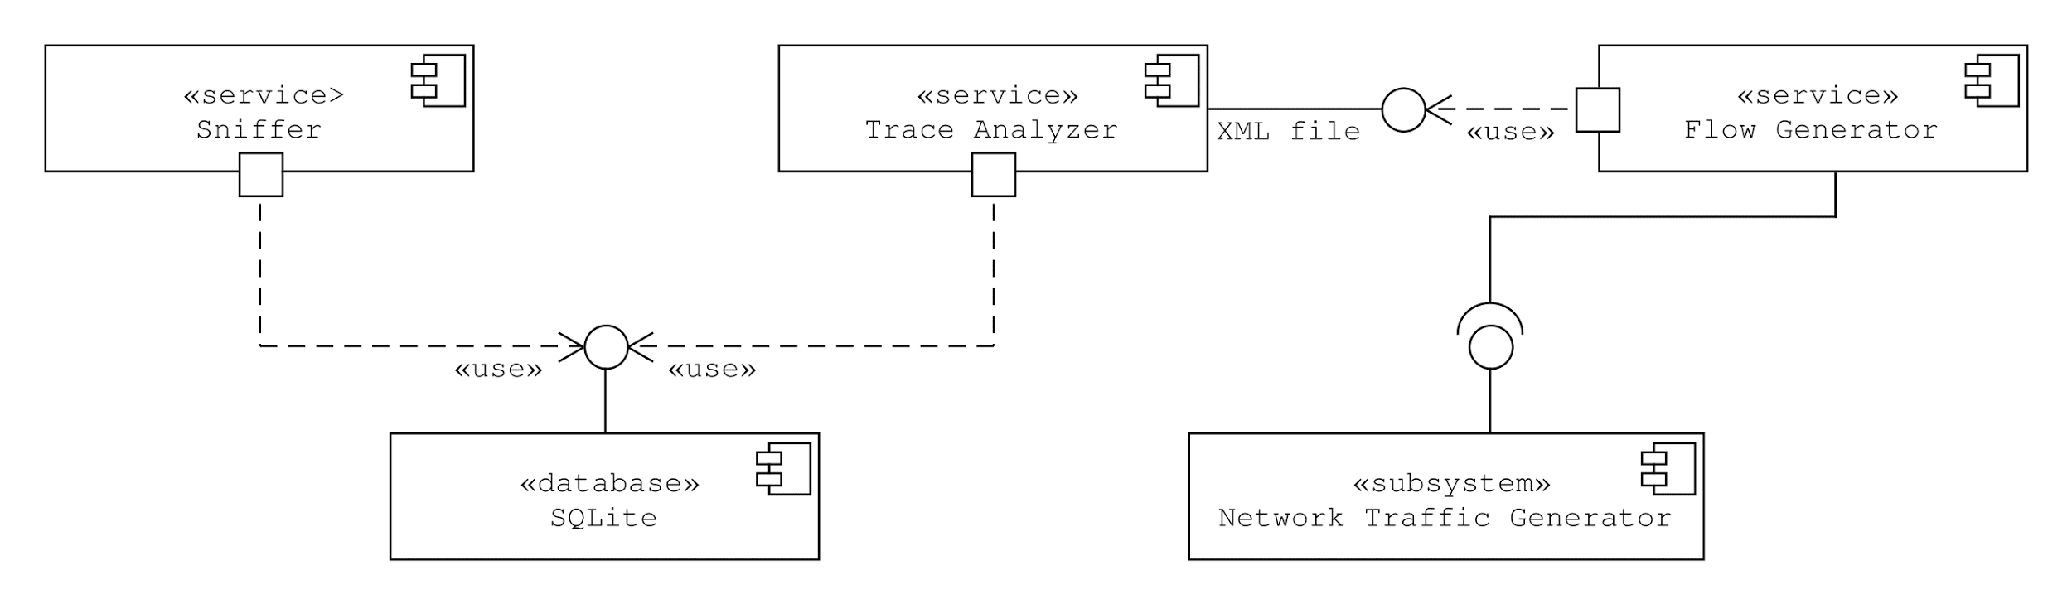
Consolidation: Architecture
Create flow-level and packet-level models to describe a given-trace, and use it as an input of a flow-generator
Flow-Generator: implemented using a traffic-generator API
Flow-Generator: extensible to any traffic-generator with API/CLI

Slide 7
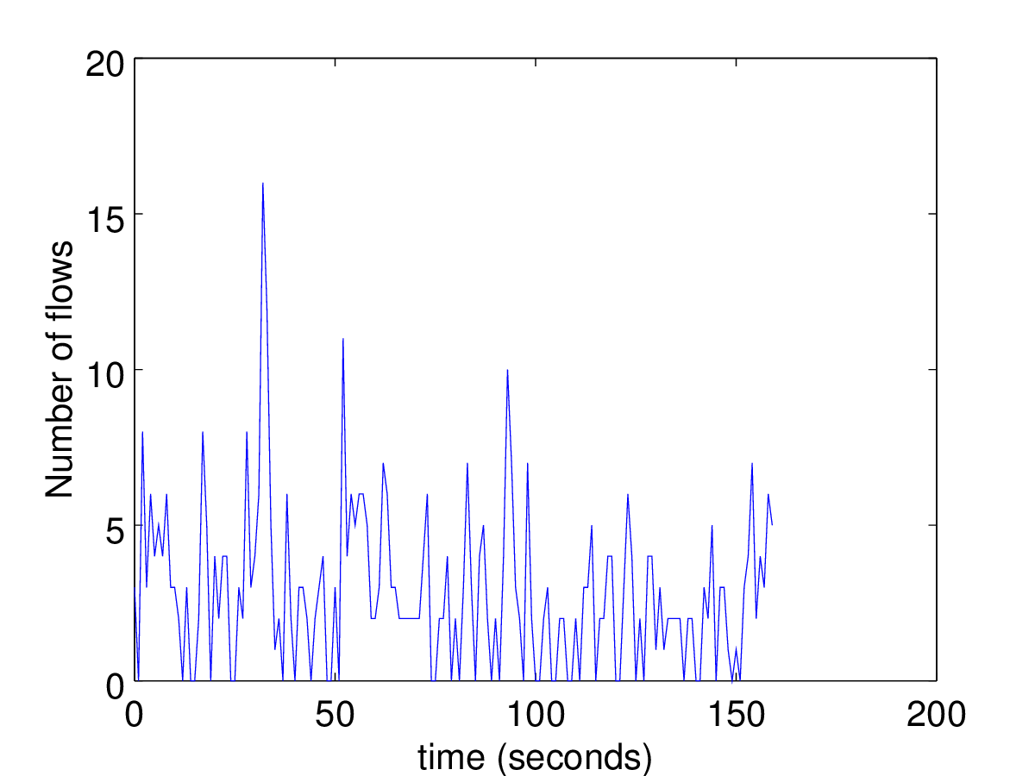
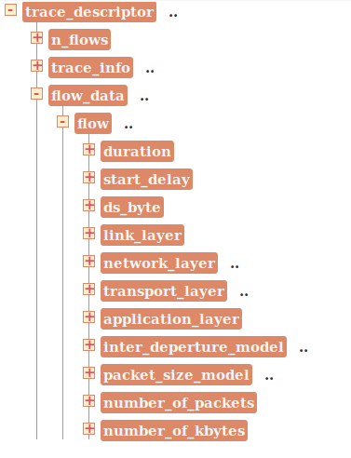

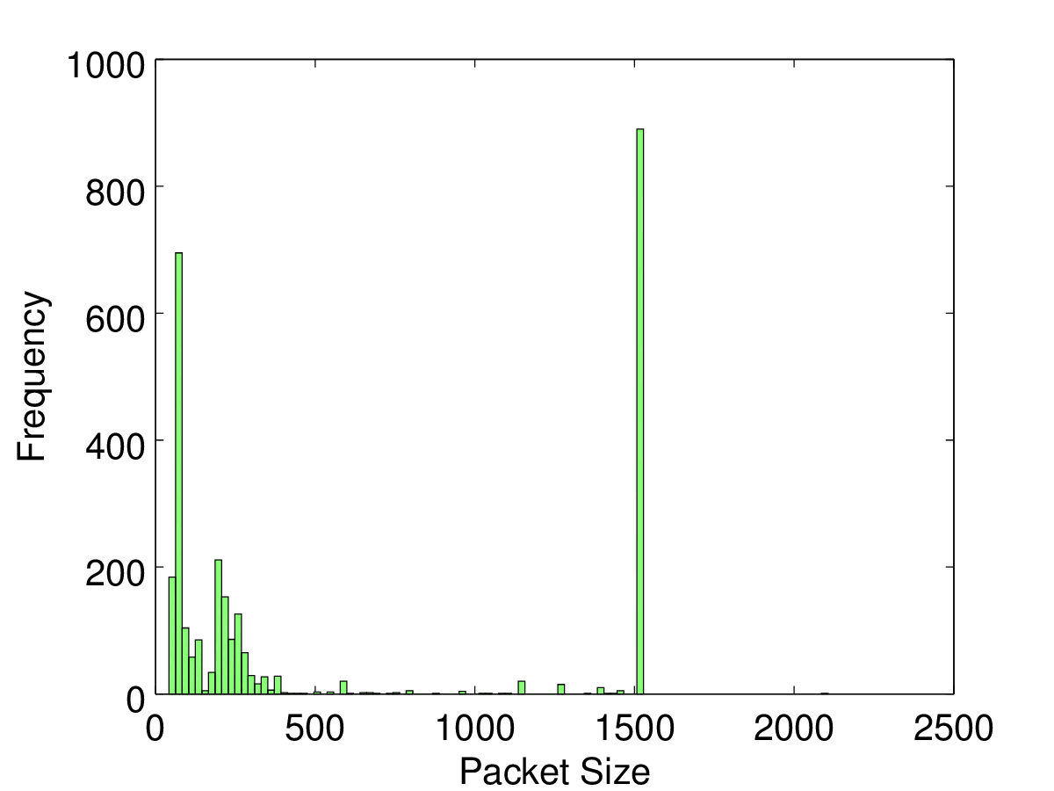
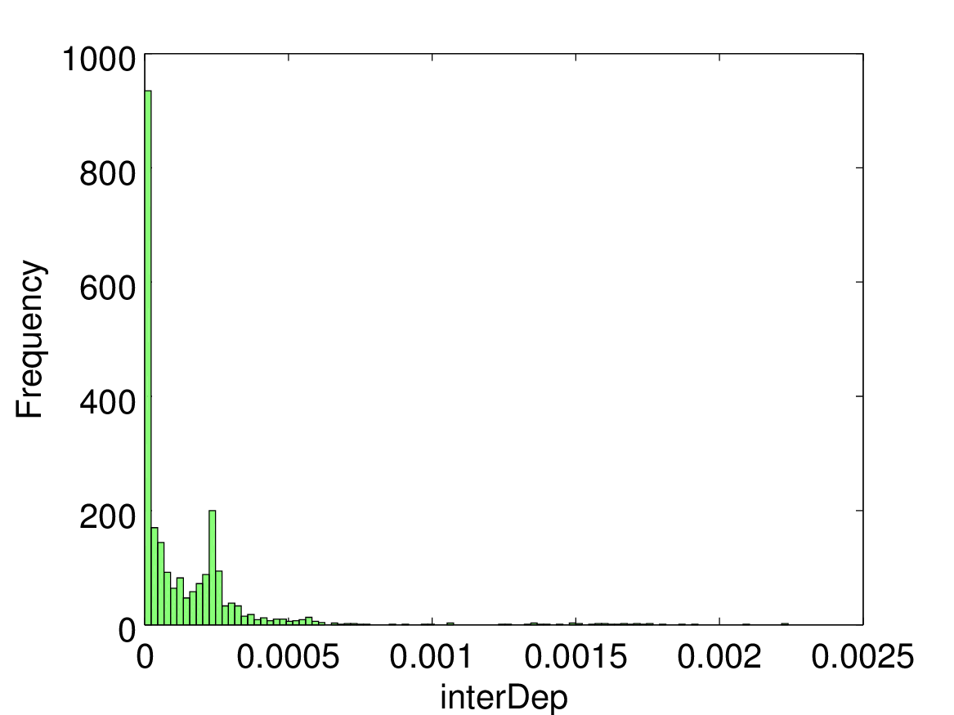

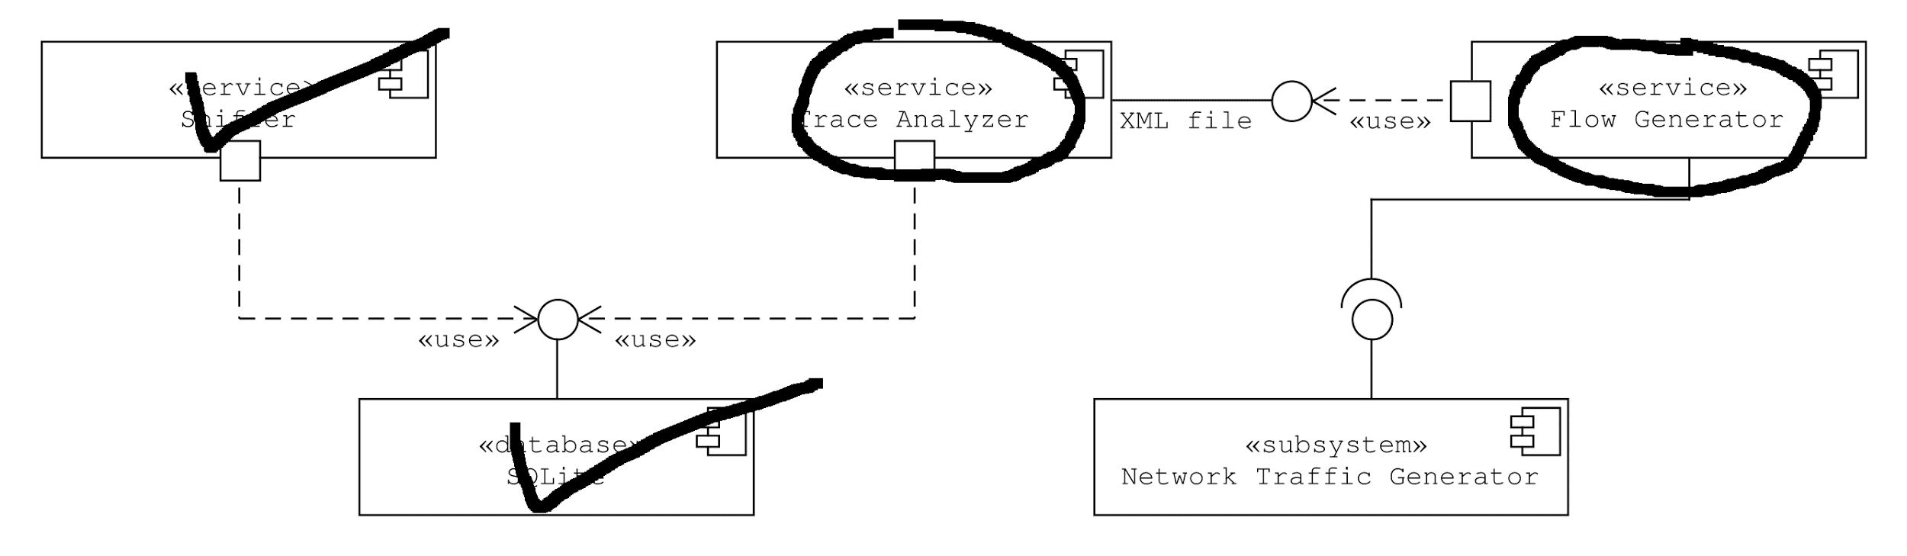
Status

Slide 8
Conclusion
Next WP
Finish Qualification
Beta: trace-analyzer and flow-generator
First results for D-ITG, and validation
Future
Extend to more Traffic Generators
Create a module to exchange of packets between Linux and DPDK (or Pktgen), and extend to NFPA

